Slide 1
Lesson 9: Creating a React Front-End
9.1 Creating a Simple React Web App
9.2 Defining Components
9.3 Creating an Industrial-Strength React Application
9.4 Building and Running an Industrial-Strength React Application
9.5 A Closer Look at Components

Slide 2
Lesson 9: Creating a React Front-End
9.1 Creating a Simple React Web App

Slide 3
Recap our Technology Stack
Web
UI
Web
server
application
Database
REST
SQL
React
Spring Boot

Slide 4
What is React?
React is a lightweight client-side library from Facebook
Helps you develop complex user interfaces
React gives you a logical way to construct your UI
You define components to render portions of the UI
React allows you to create apps for:
Web browsers, via React.js
Mobile devices, via React Native

Slide 5
Creating a Simple React Application
The easiest way to create a React application:
Import React libraries directly using scripts
Write simple JavaScript code to render HTML content
Example:
See the demo-simple-app folder
This is a minimalistic "Hello World" React app ☺

Slide 6
Importing React Libraries
To use React in a web page, import two scripts:
react.development.js
Creates views
react-dom.development.js
Renders views in a web browser
<script src="https://unpkg.com/react@17/umd/react.development.js"></script>
<script src="https://unpkg.com/react-dom@17/umd/react-dom.development.js"></script>
index.html

Slide 7
Defining an HTML Container Element
A React web app has a single HTML container element:
Note:
Give the element a suitable id
You'll tell React to render your content inside this element - see later…
<div id="app-root"></div>
index.html

Slide 8
Creating a React Element
You can create a React element programmatically as follows:
React.createElement() arguments:
The type of element to render
The element's properties
The element's children
<script>
const elem = React.createElement(
'h1',
{'title': 'My message'},
'Hello React!'
)
</script>
index.html

Slide 9
Rendering a React Element
Render your React element in a target node on the web page:
ReactDOM.render() arguments:
Your React element to render
Target node on web page
<script>
ReactDOM.render(
elem,
document.getElementById('app-root'))
</script>
index.html

Slide 10
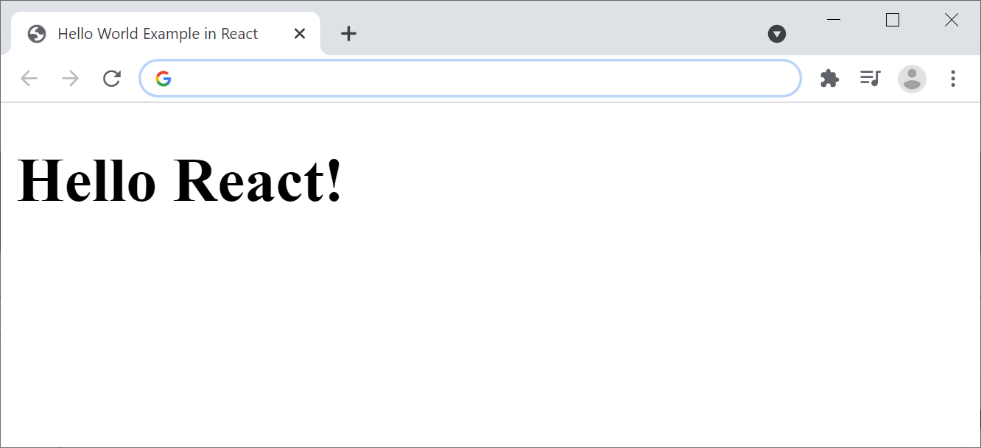
Running the Application
Simply open the web page in a browser:

Slide 11
Lesson 9: Creating a React Front-End
9.2 Defining Components

Slide 12
Overview
In a React application, you typically partition the user interface into a bunch of components
Each component is responsible for one portion of the UI
Benefits of the component approach:
Each component is small and focussed
Easier to develop
Potential reuse
Easier to test

Slide 13
How to Define Components in React
There are two ways to define a component in React…
Class-based components
This is the original approach in React
Functional components
This is the preferred approach going forward
We'll take a look at both techniques…

Slide 14
Defining a Class-Based Component
Here's how to define a class-based component:
Note:
Define a class that inherits from React.Component
Override render() and return a React element to render
class App extends React.Component {
render() {
return React.createElement(
'h1',
{'title': 'My message'},
'Hello from App class-based component!'
)
}
}
index.html

Slide 15
Defining a Functional Component
Here's how to define a functional component:
Note:
Define a function (starting with a capital)
Return a React element to render
function App() {
return React.createElement(
'h1',
{'title': 'My message'},
'Hello from App functional component!'
)
}
index.html

Slide 16
Creating and Rendering a Component
This is how you create a component and render it:
Note the first parameter to React.createElement()
It's a component name (e.g., App)
Not an HTML element (e.g., 'h1')
const elem = React.createElement(App, null, null)
ReactDOM.render(elem, document.getElementById('app-root'))
index.html

Slide 17
Lesson 9: Creating a React Front-End
9.3 Creating an Industrial-Strength React Application

Slide 18
JavaScript vs. TypeScript
JavaScript is used extensively today
But it's dynamically-typed
No compile-time help, so you hit the bugs at runtime
Many developers use TypeScript instead
You declare data types for variables
The compiler checks for correct usage

Slide 19
TypeScript and React
There are several frameworks you can use to help you create React applications in TypeScript, including:
Create React App - https://create-react-app.dev/
Next.js - https://nextjs.org/
Gatsby - https://www.gatsbyjs.com/
These tools simplify the dev/build lifecycle
Create a template application
Configure Babel/TypeScript transpilers
Configure Webpack for bundling your app

Slide 20
Using the Create React App Toolset
This is how you can use Create React App to create a React application using TypeScript:
This command also downloads React libraries and dev tools into the node_modules folder
As specified by package.json
npx create-react-app demo-industrial-strength-app --template typescript

Slide 21
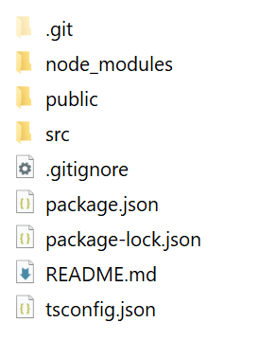
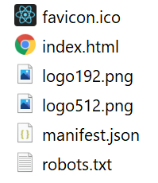
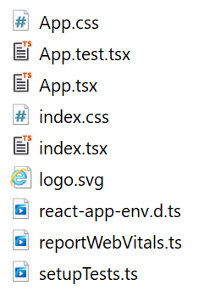
Reviewing the Application
Here's the structure of the generated application:
public folder
src folder

Slide 22
Application Home Page
The application home page is public/index.html:
<!DOCTYPE html>
<html lang="en">
<head>
<title>React App</title>
…
</head>
<body>
<div id="root"></div>
</body>
</html>
public/index.html

Slide 23
Source Code Entry Point
The source code entry point is src/index.tsx:
Note:
import React from 'react';
import ReactDOM from 'react-dom';
import './index.css';
import App from './App';
…
ReactDOM.render(
<React.StrictMode>
<App />
</React.StrictMode>,
document.getElementById('root')
);
src/index.tsx
<App />
is automatically converted into:
React.createElement(App, null, null)

Slide 24
The App Functional Components
In the generated code, App is a functional component:
import React from 'react';
import './App.css';
…
function App() {
return (
<div className="App">
<header className="App-header">
<img src={logo} className="App-logo" alt="logo" />
… Plus other HTML content …
</header>
</div>
);
}
export default App;
src/App.tsx

Slide 25
Lesson 9: Creating a React Front-End
9.4 Building and Running an Industrial-Strength React Application

Slide 26
Running the Application in Development Mode
In the app folder, run the app in dev mode as follows:
What this does:
Transpiles TS code into ES5
Transpiles JSX/TSX files into ES5
Builds the application in memory
Starts a dev server to host the app
Dev server runs on port 3000 by default
npm start
or
npx react-scripts start

Slide 27
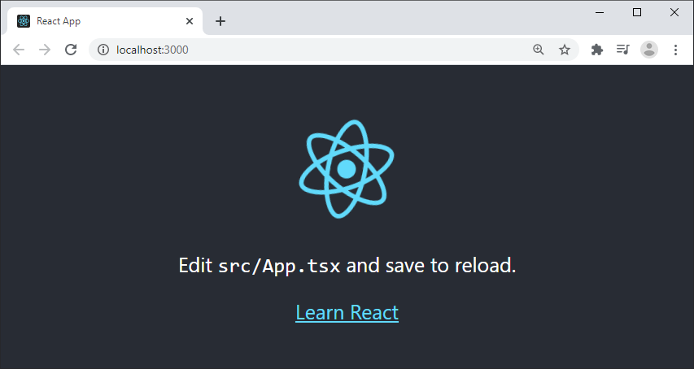
Running the Application in Development Mode
Ping the app at http://localhost:3000/

Slide 28
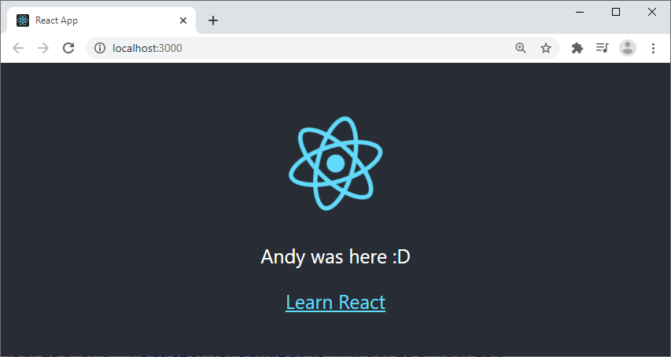
Hot Reloading
Hot reloading is supported
If you edit any source files, the app will be rebuilt and refreshed automatically in the browser

Slide 29
Building the Application for Production
In the app folder, build the app for prod mode as follows:
This creates a build folder that contains a production build of your application:
build/static/js/
build/static/css/
build/static/media/
npm run build
or
npx react-scripts build

Slide 30
Serving the Production Application
You can now run the application on a production server
E.g., install the Node "serve" server:
Then serve the production build of the app:
-s option - Location of app
-l option - Port to listen on
npm install -g serve
serve -s build -l 8080

Slide 31
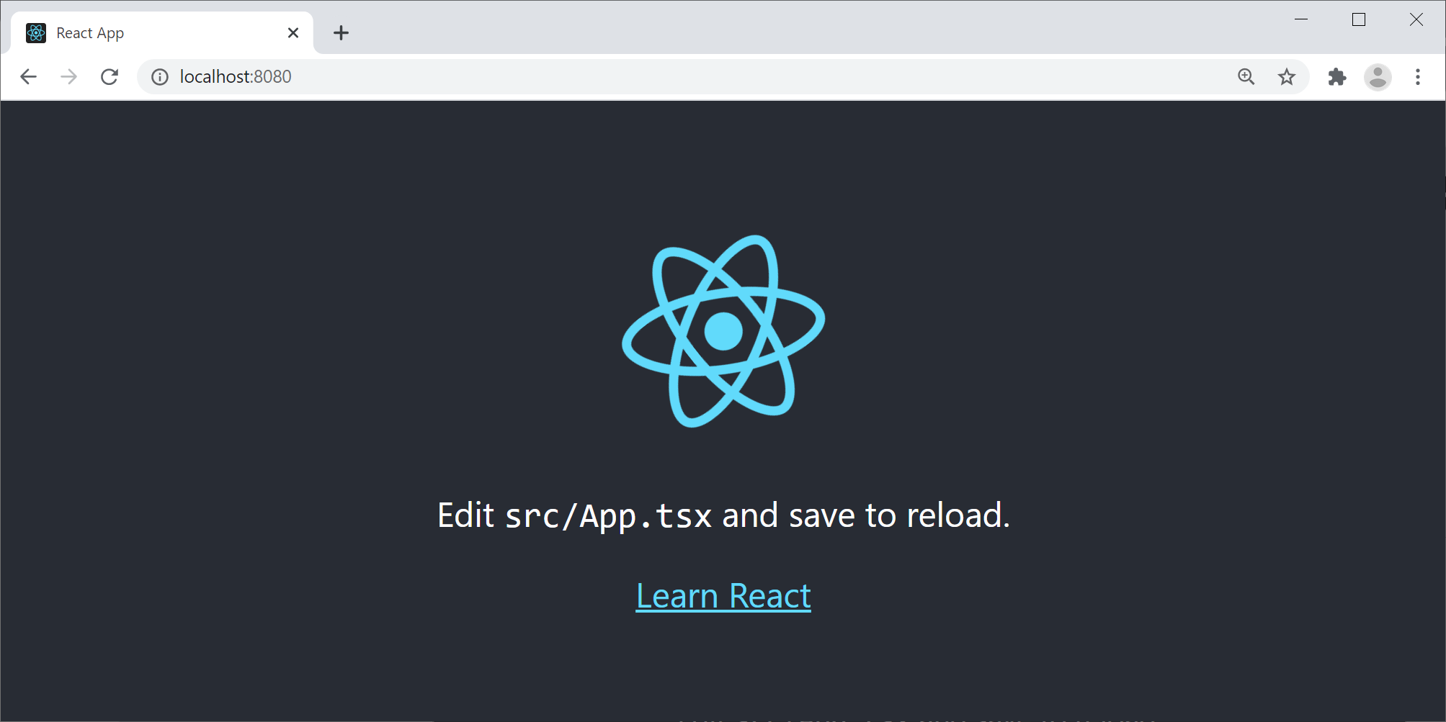
Pinging the Production Application
Open a browser and navigate to the following URL:
http://localhost:8080/

Slide 32
Lesson 9: Creating a React Front-End
9.5 A Closer Look at Components

Slide 33
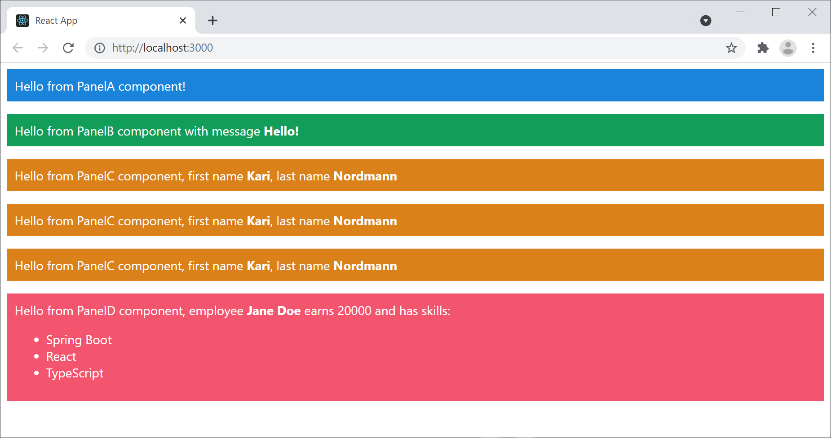
Overview
Let's see a React app that has multiple components
The root component, <App>
Plus other components to render UI panels

Slide 34
Defining and Instantiating a Component
Here’s a component that returns simple content:
We instantiate the component as follows:
export default function PanelA() {
return (
<div className="panelA">
Hello from PanelA component!
</div>
)
}
PanelA.tsx
export default function App() {
return (
<React.Fragment>
<PanelA />
… … … …
</React.Fragment>
)
}
App.tsx

Slide 35
Passing a Property to a Component
A component can receive a "properties" object:
export default function PanelB(props: any) {
const msg = props.msg
return (
<div className="panelB">
Hello from PanelB component with message <b>{msg}</b>
</div>
)
}
Note: You must enclose TS code in {}
PanelB.tsx
<PanelB msg="Hello!" />
App.tsx

Slide 36
Passing Multiple Properties
A component can receive multiple properties:
export default function PanelC(props: any) {
const fname = props.fname
const lname = props.lname
return (
<div className="panelC">
Hello from PanelC component,
first name <b>{fname}</b>,
last name <b>{lname}</b>
</div>
);
}
PanelC.tsx
<PanelC fname="Kari" lname="Nordmann" />
App.tsx

Slide 37
Passing Multiple Properties
You can also use objects, if appropriate:
{/* Create an object containing some useful properties */}
const person = {fname: 'Kari', lname: 'Nordmann'}
{/* Either pass in the object's properties one-by-one */}
<PanelC fname={person.fname} lname={person.lname} />
{/* Or use the spread operator to achieve the same effect */}
<PanelC {...person} />
App.tsx

Slide 38
Working with Complex Data
Let's see a component that consumes complex data:
export default function PanelD({name, salary, skills}: any) {
return (
<div className="panelD">
Hello from PanelD component,
employee <b>{name}</b> earns {salary}</b> and has skills:
<ul>
{skills.map((skill: string, i: number) =>
<li key={i}>{skill}</li>
)}
</ul>
</div>
);
}
PanelD.tsx
const employee = {
name: 'Jane Doe',
salary: 20_000,
skills: ['Spring Boot', 'React', 'TypeScript']
}
<PanelD {...employee} />
App.tsx

